Slide 1
NLP

Slide 2
Introduction to NLP
Deep Learning for NLP

Slide 3
Why deep learning?
Deep learning is kind of hard. Why bother with it?
Amazing results… in speech, NLP, vision/multimodal work
Does its own feature selection!
The big players (Google, Facebook, Baidu, Microsoft, IBM…) are doing a lot of this
The hot new thing?
Actually, many of the architectures that we’ll talk about were invented in the 1980s and 1990s
What’s new is hardware that can use these architectures at scale.
Notes:
Jordan, M.I. (1986). Serial order: A parallel distributed processing approach.
LSTM (1997)
Predecessor to CNNs first introduced in 1980, developed in 1988, improved in 1998.

Slide 4
Roadmap
Quick math review
Supervised machine learning in a nutshell
Sidetrack: Word embeddings
Recurrent Neural Networks (RNNs)
Long Short Term Memory Networks (LSTMs)
Convolutional Neural Networks
Tools and Links

Slide 5
Quick Math Review: Linear Algebra
This equation
3
x
2
y
5
z
7
3
x
2
y
5
z
can be written as a dot product of two vectors:
x
7
3
2
5
y
z

Slide 6
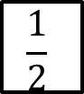
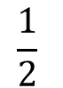
Linear Algebra
Likewise, these equations
3
x
2
y
5
z
7
-1
x
3
y
9
z
12
4
x
$$\frac{1}{2}$$
y
0
z
8
can be written as a dot product of a matrix and a vector:
3
2
5
x
7
-1
3
9
y
12
4
$$\frac{1}{2}$$
0
z
8

Slide 7
Linear Algebra Takeaway:
You can think of the dot product as applying a set of weights to your vector.
The dot product of two vectors is a scalar (a normal number, like 7 or 0.34).
The dot product of a matrix and a vector is a vector.

Slide 8
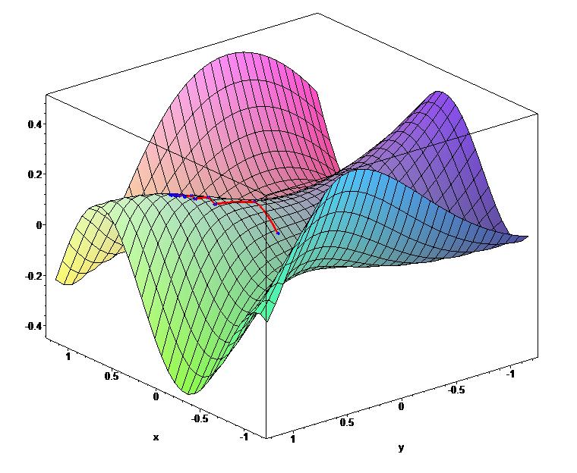
Quick Math Review: Derivatives
Derivative is a fancy word for slope.
If you are at the point where the green X is, and you want to find the point that minimizes the function, you can use the slope to figure out which way is downhill.
This works in spaces with more than two dimensions, also.
https://en.wikipedia.org/wiki/Gradient_descent

Slide 9
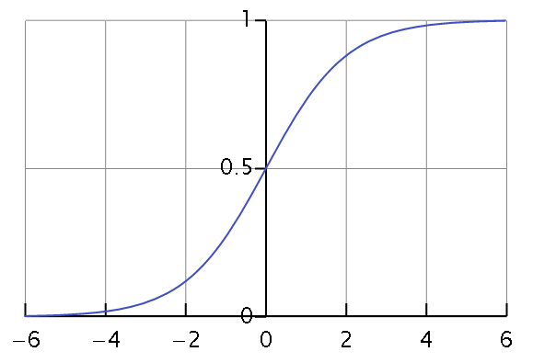
Quick Math Review: Sigmoid Function
The sigmoid function ranges from 0 to 1. Most of the time, it’s much closer to one extreme than the other. This can be nice if you want to classify something as either 0 or 1.
Also called the logistic function, this is a key component of logistic regression.
Given the shape of the curve, it’s no surprise that sigmoid is a nonlinear function
Notes:
That should be enough math to get you through today’s lecture. Now let’s take a look at the basics of supervised machine learning.

Slide 10
Supervised Machine Learning
Parameters
(things we're learning)
w
Input feature vector
x
Sigmoid or other nonlinearity
σ
ŷ
Predicted
value

Slide 11
Supervised Machine Learning
w
x
Update parameters
σ
How wrong were we?
cost( , )
ŷ
y
Actual
value

Slide 12
A Simplified Diagram
x
w
σ
y

Slide 13
What Is the Feature Vector x?
Typically a vector representation of a single character or word
Often reflects the context in which that word is found
Could just do counts, but that leads to sparse vectors
Commonly used techniques: word2vec or GloVe word embeddings
Notes:
Strictly speaking, learning word embeddings isn’t necessarily deep learning
But deep learning for NLP uses these … as do many non-deep techniques (e.g., HW3)

Slide 14
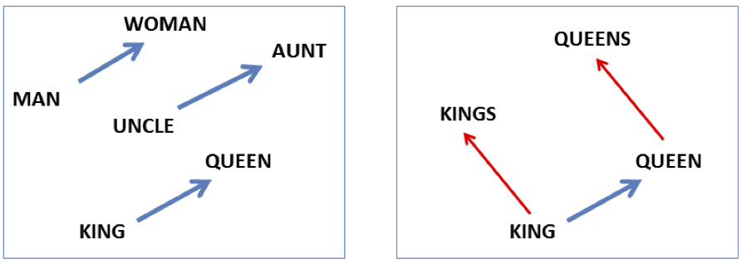
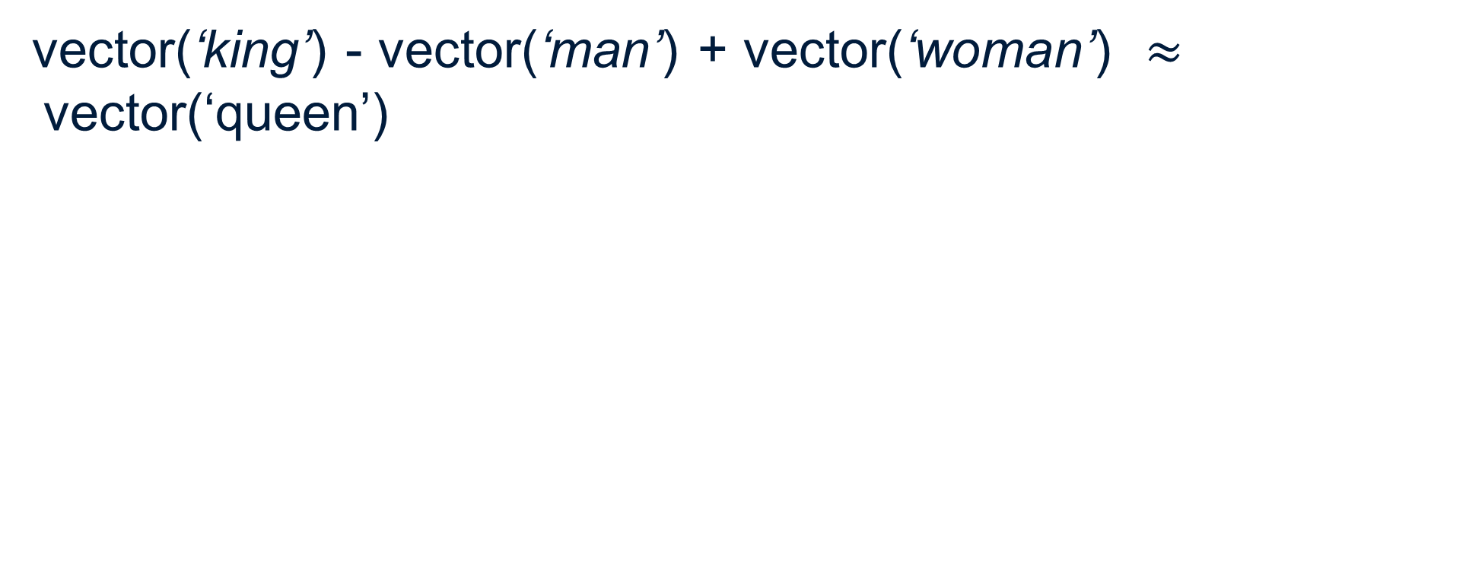
Embeddings Are Magic, Part 1
vector(‘king’) - vector(‘man’) + vector(‘woman’) $≈$vector(‘queen’)
Image courtesy of Jurafsky & Martin
http://web.stanford.edu/~jurafsky/slp3/slides/19.pptx

Slide 15
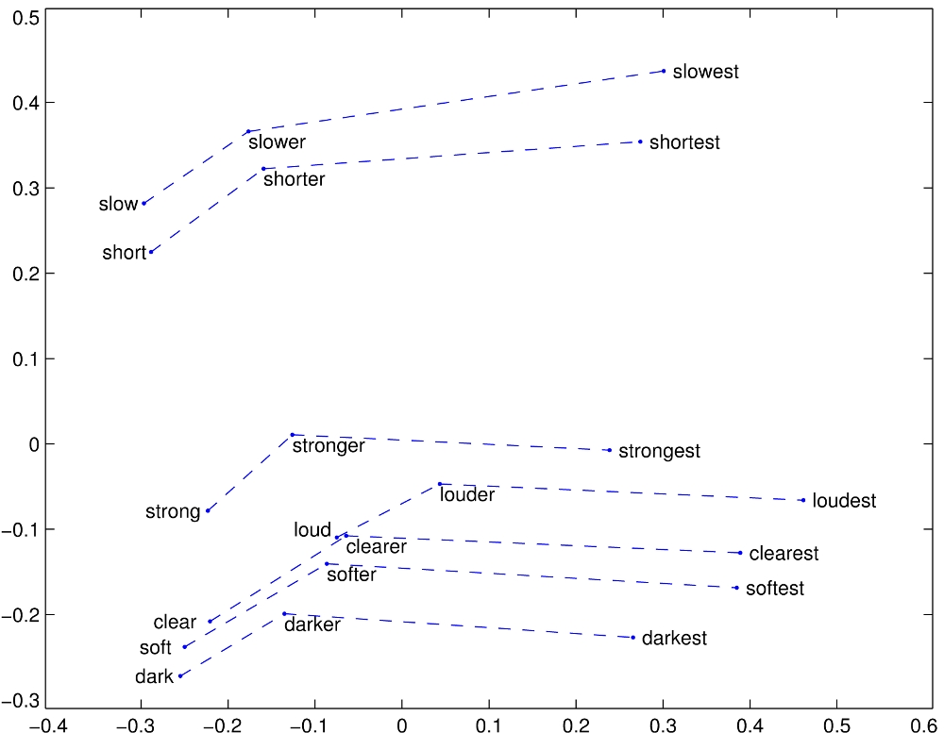
Embeddings Are Magic, Part 2
GloVe vectors for comparative and superlative adjectives
http://nlp.stanford.edu/projects/glove/images/comparative_superlative.jpg

Slide 16
word2vec
Popular group of models for word embeddings
https://code.google.com/p/word2vec/ includes the models and pre-trained embeddings
Pre-trained is good, because training takes a lot of data
Gensim: Python library that works with word2vec
https://radimrehurek.com/gensim/
Most notable models: Skipgrams and CBOW
Notes:
The pretrained models on the Google Code page are trained on about 100 billion words.

Slide 17
Skip-grams
Predict each neighboring word
in a context window of 2C words
from the current word.
So for C=2, we are given word w_{t} and predicting these 4 words:
Slide courtesy of Jurafsky & Martin

Slide 18
Skip-grams learn 2 embeddings for each w
input embedding v, in the input matrix W
Column i of the input matrix W is the 1×d embedding v_{i} for word i in the vocabulary.
output embedding v′, in output matrix W’
Row i of the output matrix W′ is a d × 1 vector embedding v′_{i} for word i in the vocabulary.
Slide courtesy of Jurafsky & Martin
Notes:
Weird notation issue: Textbook calls the output matrix C, even though these are the slides intended to correspond to the textbook chapter. The risks of working with a draft.

Slide 19
Setup
Walking through corpus pointing at word w(t), whose index in the vocabulary is j, so we’ll call it w_{j} (1 < j < |V|).
Let’s predict w(t+1), whose index in the vocabulary is k (1 < k < |V |). Hence our task is to compute P(w_{k}|w_{j}).
Slide courtesy of Jurafsky & Martin

Slide 20
One-hot vectors
A vector of length |V|
1 for the target word and 0 for other words
So if “popsicle” is vocabulary word 5
The one-hot vector is
[0,0,0,0,1,0,0,0,0…….0]
Slide courtesy of Jurafsky & Martin

Slide 21
Skip-gram
Slide courtesy of Jurafsky & Martin
Notes:
If we take our one-hot vector and multiply it by our W matrix, that gives us a vector that we call the projection layer – it’s just the column in W that corresponds to the word we’re looking at.

Slide 22
Skip-gram
h = v_{j}
o = W’h
o = W’h
Slide courtesy of Jurafsky & Martin
Notes:
We take the dot product of this projection layer, which is sometimes called h or v_j, with W’.
This gives us a vector o of values, with one value for each word in the vocabulary.
We normalize it using a function called softmax, so that the numbers in the output vectors become probabilities. The cost function then is based on how probable the model thought the correct context words were.
CBOW, or continuous bag of words, is like backwards skipgram: given the context words, try to predict the target word.
So now we know what our input is going to be. Let’s look at some networks that use them.

Slide 23

Recurrent Neural Networks (RNNs)
$h_{t}=$ $σ(W_{h}h_{t−1}+W_{x}x_{t})$
h₀
w_{h}
h₁
σ
w_{x}
x₁
Notes:
Remember our notation from earlier. X is an input, h is our hidden layer, Ws are our weights, sigma is a nonlinearity – typically a sigmoid or tanh function.

Slide 24

RNN
y₁
$h_{t}=$ $σ\left(W_{h}h_{t−1}+W_{x}x_{t}\right)$
$$y_{t}=softmax(W_{y}h_{t})$$
softmax
w_{y}
h₀
w_{h}
h₁
σ
w_{x}
x₁
Notes:
As much as we love hidden layers, we probably want some actual output, so we can apply another set of weights and a softmax to h_t to give us our predicted probabilities for y_t

Slide 25
RNN
y₃
softmax
w_{y}
h₀
w_{h}
h₁
w_{h}
h₂
w_{h}
h₃
σ
σ
σ
w_{x}
w_{x}
w_{x}
x₁
x₂
x₃
The
cat
sat
Notes:
Reason to use RNNs is you have a sequence, such as a sentence.

Slide 26
Updating Parameters of an RNN
y₃
Cost
softmax
w_{y}
h₀
w_{h}
h₁
w_{h}
h₂
w_{h}
h₃
σ
σ
σ
w_{x}
w_{x}
w_{x}
x₁
x₂
x₃
The
cat
sat
Notes:
RNNs are supervised, so once you have your predictions y, you compare them to your correct label for the sequence. For a classification problem, you use something like categorical cross entropy, and you get a cost. You then take the gradient of the cost w.r.t. the parameters to figure out how to update your parameters.

Slide 27
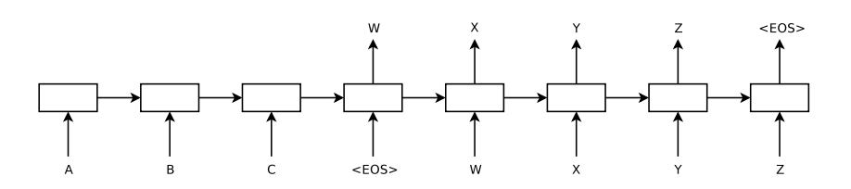
Example Application: Machine Translation
Sequence-to-sequence learning (Sutskever, Vinyals, and Le, 2014)

Slide 28
Other Application Examples
RNN for slot filling task
Character-level RNNs for text generation
Remember SRL from last week’s lecture? http://www.aclweb.org/anthology/P15-1109
Dependency parsing: http://www.aclweb.org/anthology/K/K15/K15-1015.pdf (“producing state-of-art dependency parsing results while requiring minimal feature engineering”)

Slide 29
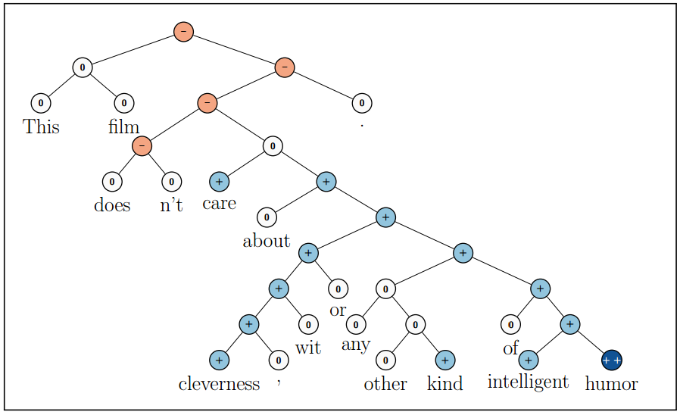
Recursive Neural Networks Example: Sentiment Analysis
Socher et al. (2013)
Recursive Deep Models for Semantic Compositionality Over a Sentiment Treebank

Slide 30
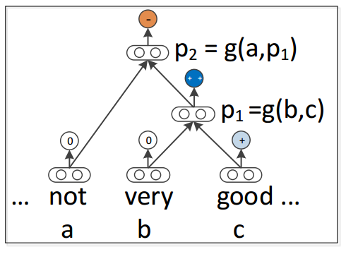
Recursive Neural Networks
Socher et al. (2013)
Recursive Deep Models for Semantic Compositionality Over a Sentiment Treebank

Slide 31
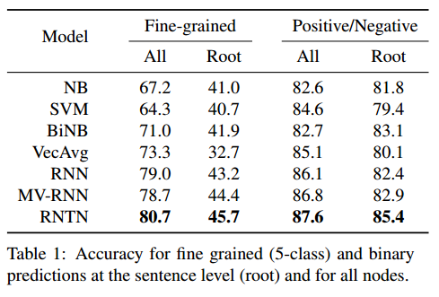
Recursive Neural Networks
Socher et al. (2013)
Recursive Deep Models for Semantic Compositionality Over a Sentiment Treebank

Slide 32
LSTM Motivation
Remember how we update an RNN?
y₃
Cost
softmax
w_{y}
h₀
w_{h}
h₁
w_{h}
h₂
w_{h}
h₃
σ
σ
σ
w_{x}
w_{x}
w_{x}
x₁
x₂
x₃
The
cat
sat
Notes:
RNNs are supervised, so once you have your predictions y, you compare them to your correct label for the sequence. For a classification problem, you use something like categorical cross entropy, and you get a cost. You then take the gradient of the cost w.r.t. the parameters to figure out how to update your parameters.

Slide 33
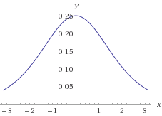
The Vanishing Gradient Problem
Deep neural networks use backpropagation.
Back propagation uses the chain rule.
The chain rule multiplies derivatives.
Often these derivatives between 0 and 1.
As the chain gets longer, products get smaller
until they disappear.
Wolfram|Alpha
Derivative of sigmoid function

Slide 34
Or do they explode?
With gradients larger than 1,
you encounter the opposite problem
with products becoming larger and larger
as the chain becomes longer and longer,
causing overlarge updates to parameters.
This is the exploding gradient problem.

Slide 35

Vanishing/Exploding Gradients Are Bad.
If we cannot backpropagate very far through the network, the network cannot learn long-term dependencies.
My dog [chase/chases] squirrels.
vs.
My dog, whom I adopted in 2009, [chase/chases] squirrels.

Slide 36
LSTM Solution
Use memory cell to store information at each time step.
Use “gates” to control the flow of information through the network.
Input gate: protect the current step from irrelevant inputs
Output gate: prevent the current step from passing irrelevant outputs to later steps
Forget gate: limit information passed from one cell to the next

Slide 37

Transforming RNN to LSTM
$u_{t}=$ $σ(W_{h}h_{t−1}+W_{x}x_{t})$
h₀
w_{h}
u₁
σ
w_{x}
x₁
Notes:
Start with the same basic structure as our RNN, but call the output vector u1 instead of h1.

Slide 38
Transforming RNN to LSTM
c₀
h₀
w_{h}
u₁
σ
w_{x}
x₁
Notes:
Now we’re going to add another vector, c, which will be our memory cell. C0 is usually initialized to all 0s, and we’ll see how c is calculated for each time-step in a moment.
Basically, we’re going to want to somehow combine c0 with u1 to get c1. There’s a temptation to apply a set of weights to each and then apply some non-linear function, but that’s what got us into this mess, so let’s not do that.

Slide 39
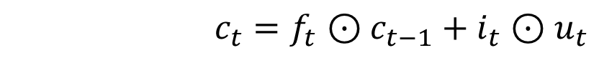
Transforming RNN to LSTM
c₀
c₁
f₁
$$c_{t}=f_{t}⊙c_{t−1}+i_{t}⊙u_{t}$$
+
h₀
w_{h}
u₁
σ
i₁
w_{x}
x₁
Notes:
Instead, what we’re going to do is pass u1 through our input gate i1, and pass c0 through our forget gate f1, and take their sum. When I say information is “passed through” a gate, I mean take the elementwise product of the input vector and the gate vector.

Slide 40
Transforming RNN to LSTM
c₀
c₁
f₁
$$c_{t}=f_{t}⊙c_{t−1}+i_{t}⊙u_{t}$$
+
h₀
w_{h}
u₁
σ
i₁
w_{x}
x₁
Notes:
It’s a big deal that c is calculated using a linear function.

Slide 41
Transforming RNN to LSTM
c₀
c₁
f₁
$$c_{t}=f_{t}⊙c_{t−1}+i_{t}⊙u_{t}$$
+
h₀
w_{h}
u₁
σ
i₁
w_{x}
x₁
Notes:
The gate vector will have values from 0 to 1. A gate value of 0 is closed: it doesn’t let information pass through it. A gate value of 1 lets all of the information pass through it.
At this first time step, the gates aren’t doing much, because we initialized c0 and h0 to vectors of zeros. But at the next time step, our gates give the network the option of treating the input c as a vector of zeros. So if ct is a memory of everything we’ve seen in the network up to time t, we can totally close our gate and use all 0s for ct at the next step – effectively forgetting everything and going back to our starting value for c. The gate vector will have values from 0 to 1. A gate value of 0 is closed: it doesn’t let information pass through it. A gate value of 1 lets all of the information pass through it.

Slide 42
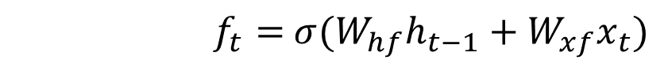
Transforming RNN to LSTM
c₀
c₁
f₁
$f_{t}=$ $σ(W_{hf}h_{t−1}+W_{xf}x_{t})$
f₁
+
w_{hf}
σ
h₀
h₀
w_{h}
u₁
σ
w_{xf}
i₁
w_{x}
x₁
x₁
Notes:
So, where do the magic gates come from? Why, we multiply some input vectors by weights and apply the sigmoid function, of course! The forget gate gets one set of weights…

Slide 43
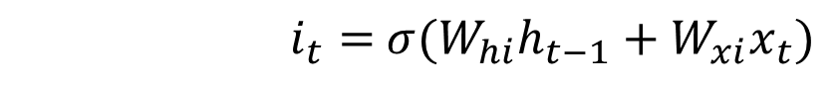
Transforming RNN to LSTM
c₀
c₁
f₁
$i_{t}=$ $σ(W_{hi}h_{t−1}+W_{xi}x_{t})$
+
w_{hi}
σ
h₀
u₁
h₀
w_{h}
i₁
σ
w_{xi}
i₁
w_{x}
x₁
x₁
Notes:
And the input gate gets a different set.

Slide 44
Transforming RNN to LSTM
c₀
c₁
f₁
$$h_{t}=o_{t}⊙\tanh{c_{t}}$$
+
tanh
h₀
w_{h}
u₁
h₁
σ
i₁
o₁
w_{x}
x₁
Notes:
Finally, we apply a non-linearity to our memory cell, c1, and pass that through the output gate to give us h1

Slide 45
LSTM for Sequences
c₀
c₁
c₂
f₂
c₂
f₁
+
f₂
+
+
tanh
tanh
tanh
h₀
w_{h}
u₁
h₁
w_{h}
u₂
h₂
w_{h}
u₂
h₂
σ
i₁
o₁
σ
i₂
o₂
σ
i₂
o₂
w_{x}
w_{x}
w_{x}
x₁
x₂
x₂
The
cat
sat
Notes:
Now, we can line these up like we did with the regular RNN and start processing sequences

Slide 46
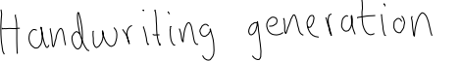
LSTM Applications
http://www.cs.toronto.edu/~graves/handwriting.html
Language identification (Gonzalez-Dominguez et al., 2014)
Paraphrase detection (Cheng & Kartsaklis, 2015)
Speech recognition (Graves, Abdel-Rahman, & Hinton, 2013)
Handwriting recognition (Graves & Schmidhuber, 2009)
Music composition (Eck & Schmidhuber, 2002) and lyric generation (Potash, Romanov, & Rumshisky, 2015)
Robot control (Mayer et al., 2008)
Natural language generation (Wen et al. 2015) (best paper at EMNLP)
Named entity recognition (Hammerton, 2003)
… and many more

Slide 47
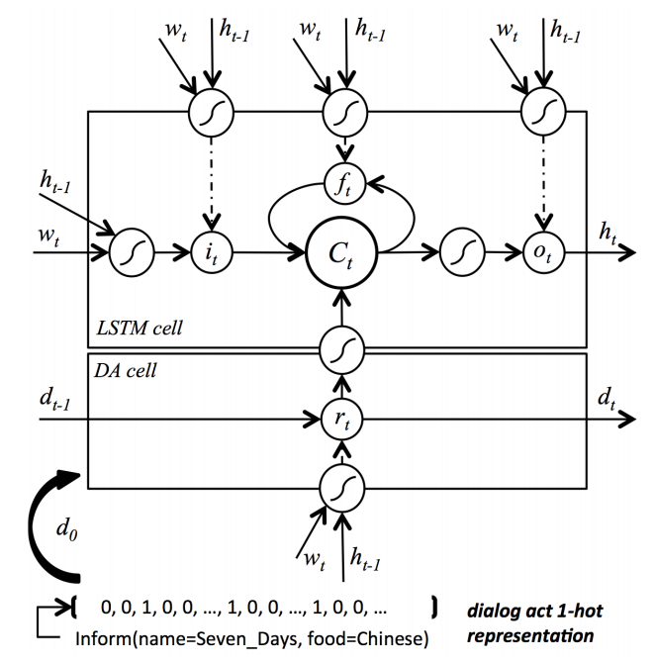
Example: Language Generation
Wen et al. (2015)
Semantically Conditioned LSTM-based Natural Language Generation for Spoken Dialogue Systems
Notes:
Slightly confusing notation in this diagram: they call the x’s w for word. And they don’t show the weights at all, but of course there are weights.

Slide 48
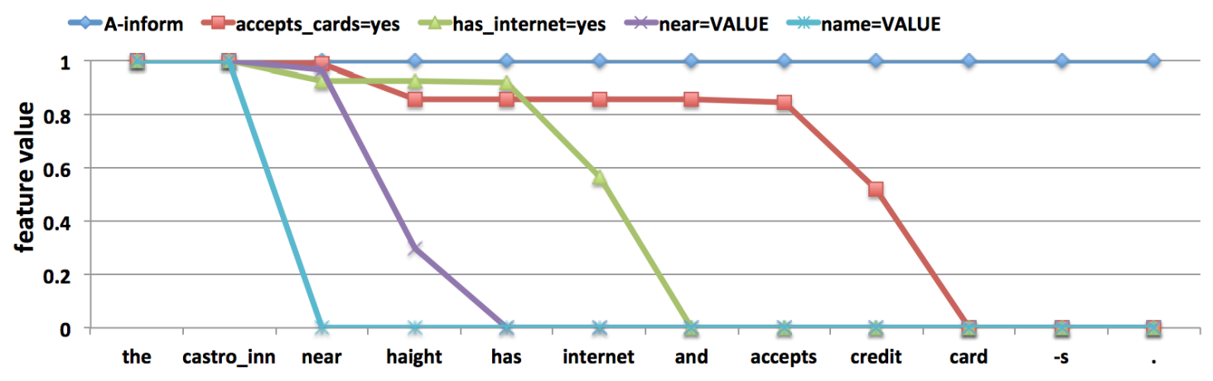
Wen et al., 2015 (continued)

Slide 49
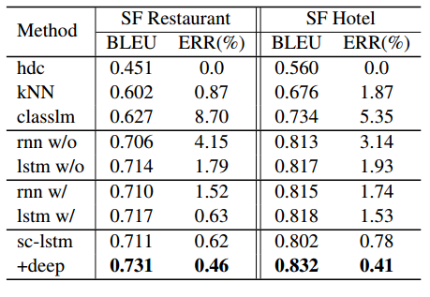
Wen et al., 2015 (continued)

Slide 50
Related Architectures: GRU
z₁
h₀
w_{h}
ĥ₁
h₁
r₁
σ
+
w_{x}
1-z₁
x₁
Chung et al. (2014) reports comparable performance to LSTM

Slide 51
Related Architectures: Tree LSTMs
f
c₀
h₀
u₂
c₂
h₂
x₂
i
o
c₁
h₁
f
Tai, Socher, Manning 2015

Slide 52

Cats’ Brains and CNNs
With the exception of distinguishing cucumbers from deadly snakes, cats’ brains are really good at image classification.
Yann LeCun et al. (1998) found that a neural network that works like a cat’s visual cortex was good at digit classification.
When machines got powerful enough, it also turned out to be great at image classification. (Krizhevsky et al. 2012)
(Don’t do this to your cat.
It can traumatize them.)
Notes:
But the machines available in 1998 didn’t have the power to use this for much more than digit classification, so real image work with CNNs had to wait for better GPUs.

Slide 53
Basic Idea of CNNs
Hidden layer
Input
Notes:
Suppose we have a picture coming into the cat’s

Slide 54
Basic Idea of CNNs
Hidden layer
Input

Slide 55
Basic Idea of CNNs
Hidden layer
Input

Slide 56
Basic Idea of CNNs
Hidden layer
Input
Notes:
And of course, we like deep networks, so let’s add another layer where we pool this hidden layer into one neuron.
The set of weights that’s learned for the window becomes a filter. A filter looks for the same feature in each sub-region of the input. So, for example, if diagonal lines turn out to be an important feature, your hidden layer will become a map of where the diagonal lines were in the input.

Slide 57
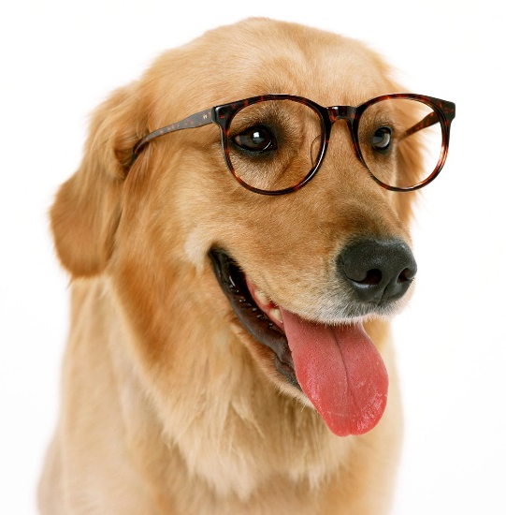
CNN for Image Classification
Convolutional Layer

Slide 58
CNN for Image Classification
Convolutional Layer
Notes:
You slide the window over the image, and you apply the same weights at each spot, and you come up with a feature map that shows you where the feature these weights are good at detecting shows up in the image. But probably you want more than one feature.

Slide 59
CNN for Image Classification
Convolutional Layer
Notes:
So you slide another set of weights, and the idea is that those will learn a filter for another feature. So right now we’re just learning low level features, and maybe blue learned to recognize diagonal lines, and orange learns horizontal.

Slide 60
CNN for Image Classification
Convolutional Layer
Notes:
And you keep doing that until you get feature maps for a bunch of features. Now you want to do something to combine them,

Slide 61
CNN for Image Classification
Convolutional Layer
Notes:
And you keep doing that until you get feature maps for a bunch of features. Now you want to do something to combine them,

Slide 62
CNN for Image Classification
Max Pooling
Notes:
Now you have this pile of matrices, each of which is a feature map. The next step is called max pooling. You look at some number of adjacent squares in your matrix, keep the one with the highest value, and throw away the rest.
This has a few benefits. One is that it makes the model more robust to minor shifts in the image. Another is that it can allow us to deal with inputs of varying sizes. And another is that we’ve got a lot of squares that don’t really tell us anything important.

Slide 63
CNN for Image Classification
Max Pooling
Notes:
Max pooling pools several squares and takes their max to represent the whole pool.

Slide 64
CNN for Image Classification
Max Pooling

Slide 65
CNN for Image Classification
Max Pooling
Notes:
We apply max pooling to all the layers, and now we have a smaller matrix with the most important information from each matrix in the convolutional step.

Slide 66
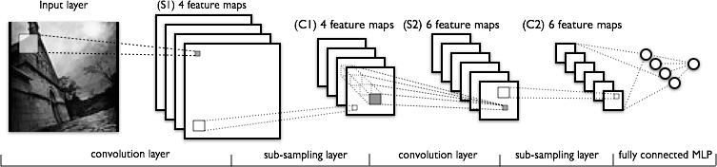
CNN for Image Classification
http://deeplearning.net/tutorial/lenet.html
Notes:
If you alternate those layers -- the convolution layer and a max pooling layer – you can build a LeNet, the type of CNN designed by Yann LeCunn.
MLP = Multi-layer perceptron: fully connected input layer, hidden layer, and output.

Slide 67
CNN for Image Classification
How good are CNNs?
“We also entered a variant of this model in the ILSVRC-2012 competition and achieved a winning top-5 test error rate of 15.3%, compared to 26.2% achieved by the second-best entry.”
Krizhevsky et al., 2012: ImageNet Classification with Deep Convolutional Neural Networks
Competition to classify photos from ImageNet, http://www.image-net.org/

Slide 68
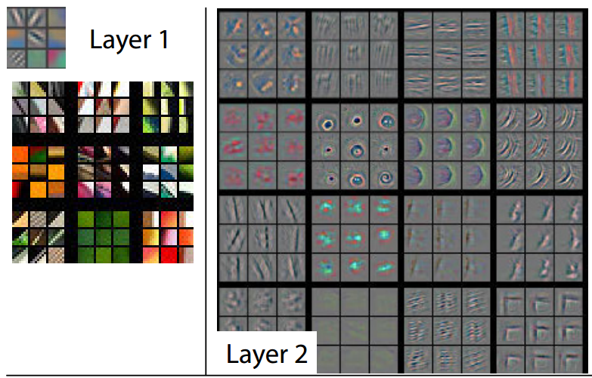
CNN for Image Classification
Learned Filters
Zeiler and Fergus 2014
Notes:
We must go deeper!

Slide 69
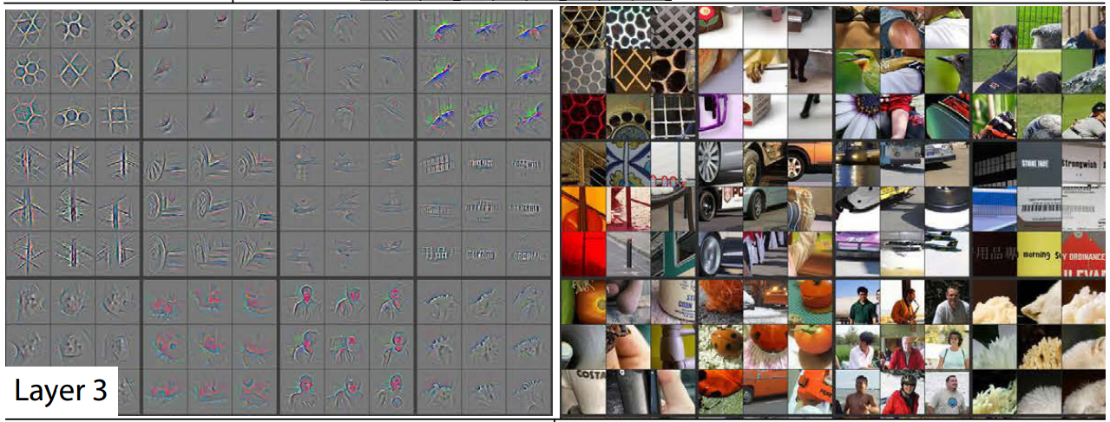
CNN for Image Classification
Zeiler and Fergus 2014

Slide 70
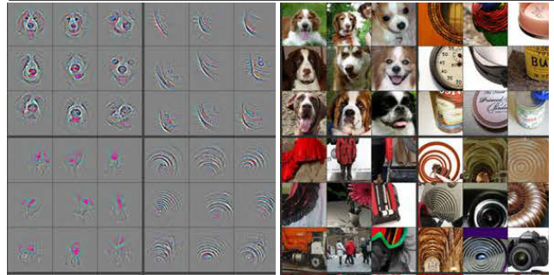
CNN for Image Classification
Layer 4
Zeiler and Fergus 2014

Slide 71
So, What Can They Do for NLP?
Convolutional Neural Network for Paraphrase Identification (Yin & Schütze 2015)
Summarization-based Video Caption via Deep Neural Networks (Li et al. 2015)
Question Answering over Freebase with Multi-Column Convolutional Neural Networks (Dong et al. 2015)
Convolutional Neural Network Architectures for Matching Natural Language Sentences (Hu et al. 2015)
Learning Semantic Representations Using Convolutional Neural Networks for Web Search (Sheng et al. 2015)
Deep Convolutional Neural Networks for Sentiment Analysis of Short Texts (dos Santos & Gatti 2014)
Relation Extraction: Perspective from Convolutional Neural Networks (Nguyen & Grishman 2015)
Modeling Mention, Context and Entity with Neural Networks for Entity Disambiguation (Sun et al. 2015)
Modeling Interestingness with Deep Neural Networks (Gao 2015)
… and so on

Slide 72
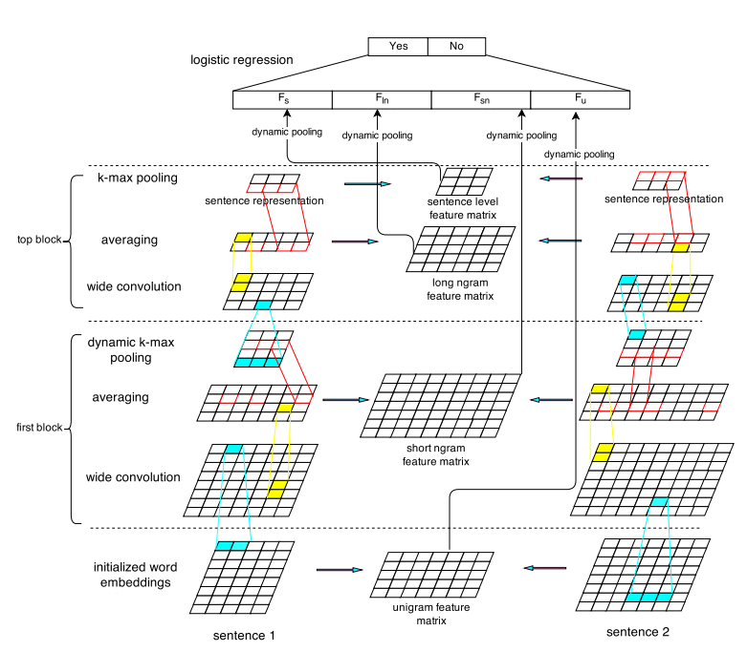
Example Application: Paraphrase Detection
(Yin & Schütze 2015)

Slide 73
Tools for Deep Learning
Theano (Python): http://deeplearning.net/software/theano/
Lasagne: Built on top of Theano, has pre-designed networks: https://github.com/Lasagne/Lasagne
Torch (Lua): http://torch.ch/
TensorFlow (Python and C++): https://www.tensorflow.org/

Slide 74
Want to Learn More About Deep Learning?
Richard Socher’s Stanford class: http://cs224d.stanford.edu/
Learn Theano + deep learning in one tutorial http://deeplearning.net/tutorial/
http://web.eecs.umich.edu/~radev/dlnlp/list.txt

Slide 75
Is everything else we’ve learned this semester moot?
Given how magical deep learning is, why do anything else?
Deep learning requires a lot of data… seriously, a lot. Sometimes we don’t have enough data.
Deep learning requires a lot of computing power.
Benefits of combining power of deep learning with linguistic knowledge
Notes:
To quantify “a lot,” it’s not uncommon to see a paper pretrain on 100,000 or 300,000 sentences before they train for the real task. I’ve been working with a dataset of around 5,000 sentence pairs, and it’s nowhere near enough to train an LSTM.
The exact amount of data is going to vary by architecture and by the quality of the data for the task.
Similarly, how much computing power we need will vary by application. I ran an experiment a week ago to test a tree LSTM. Because I was just testing it out, I only had it run 5 epochs. It nearly monopolized 24 cores on our lab’s server and ran for 24 hours. You can get better speed using expensive hardware.

